Slide 1
Micro Credit Defaulter model
By Biranchi Narayan nath

Slide 2
Problem Statement
A Telecom Industry collaborating with an MFI provides micro-credit on mobile balance to poor families living in remote areas with not much source of income.
The loan repayment have a fixed time of 5 days to return back to the company.
Here the problem is to create a model which will Identify defaulter and non-defaulter customer .

Slide 3
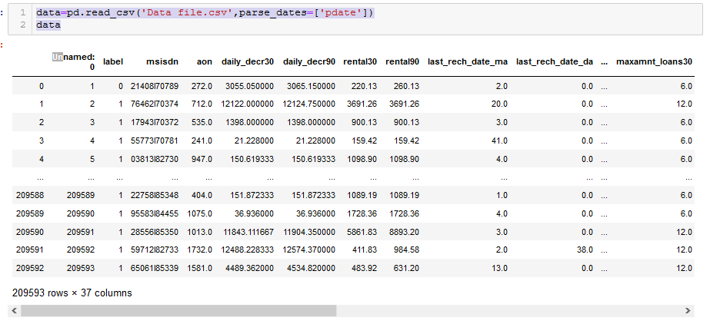
Data set

Slide 4
Dataset Information
The shape of the dataset is (209593,37).
The dataset has 21 Float, 13 integer , 2 object and 1 date columns.
The Binary classification have 87.5% of Non-defaulter and 12.5% of defaulter classes.

Slide 5
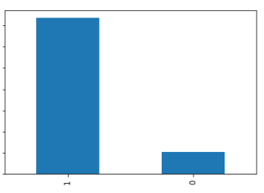
Distribution of labels

Slide 6
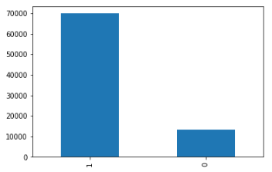
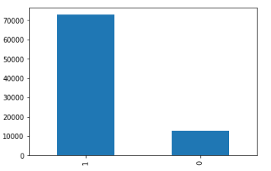
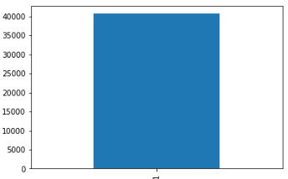
Monthwise chart of label
June
July
August
.
.
.

Slide 7
